Slide 1

DIFFERENTIANTOO
(A Derivative Calculator)
Presented By
Shafiq-us Saleheen
Exam Roll - 1117
Roll - 1125
Session - 2018-19
Supervised By
Dr. Sumon Ahmed
Associate Professor
Institute of Information Technology
University of Dhaka

Slide 2

WHAT IS DIFFERENTIANTOO?
Finds derivative of a given function
Shows steps of how the calculation is done
Includes important derivative formulas with example

Slide 3
WHY IS DIFFERENTIANTOO?
1
Useful for learners
2
Accuracy of calculations
3
Easy solving technique

Slide 4
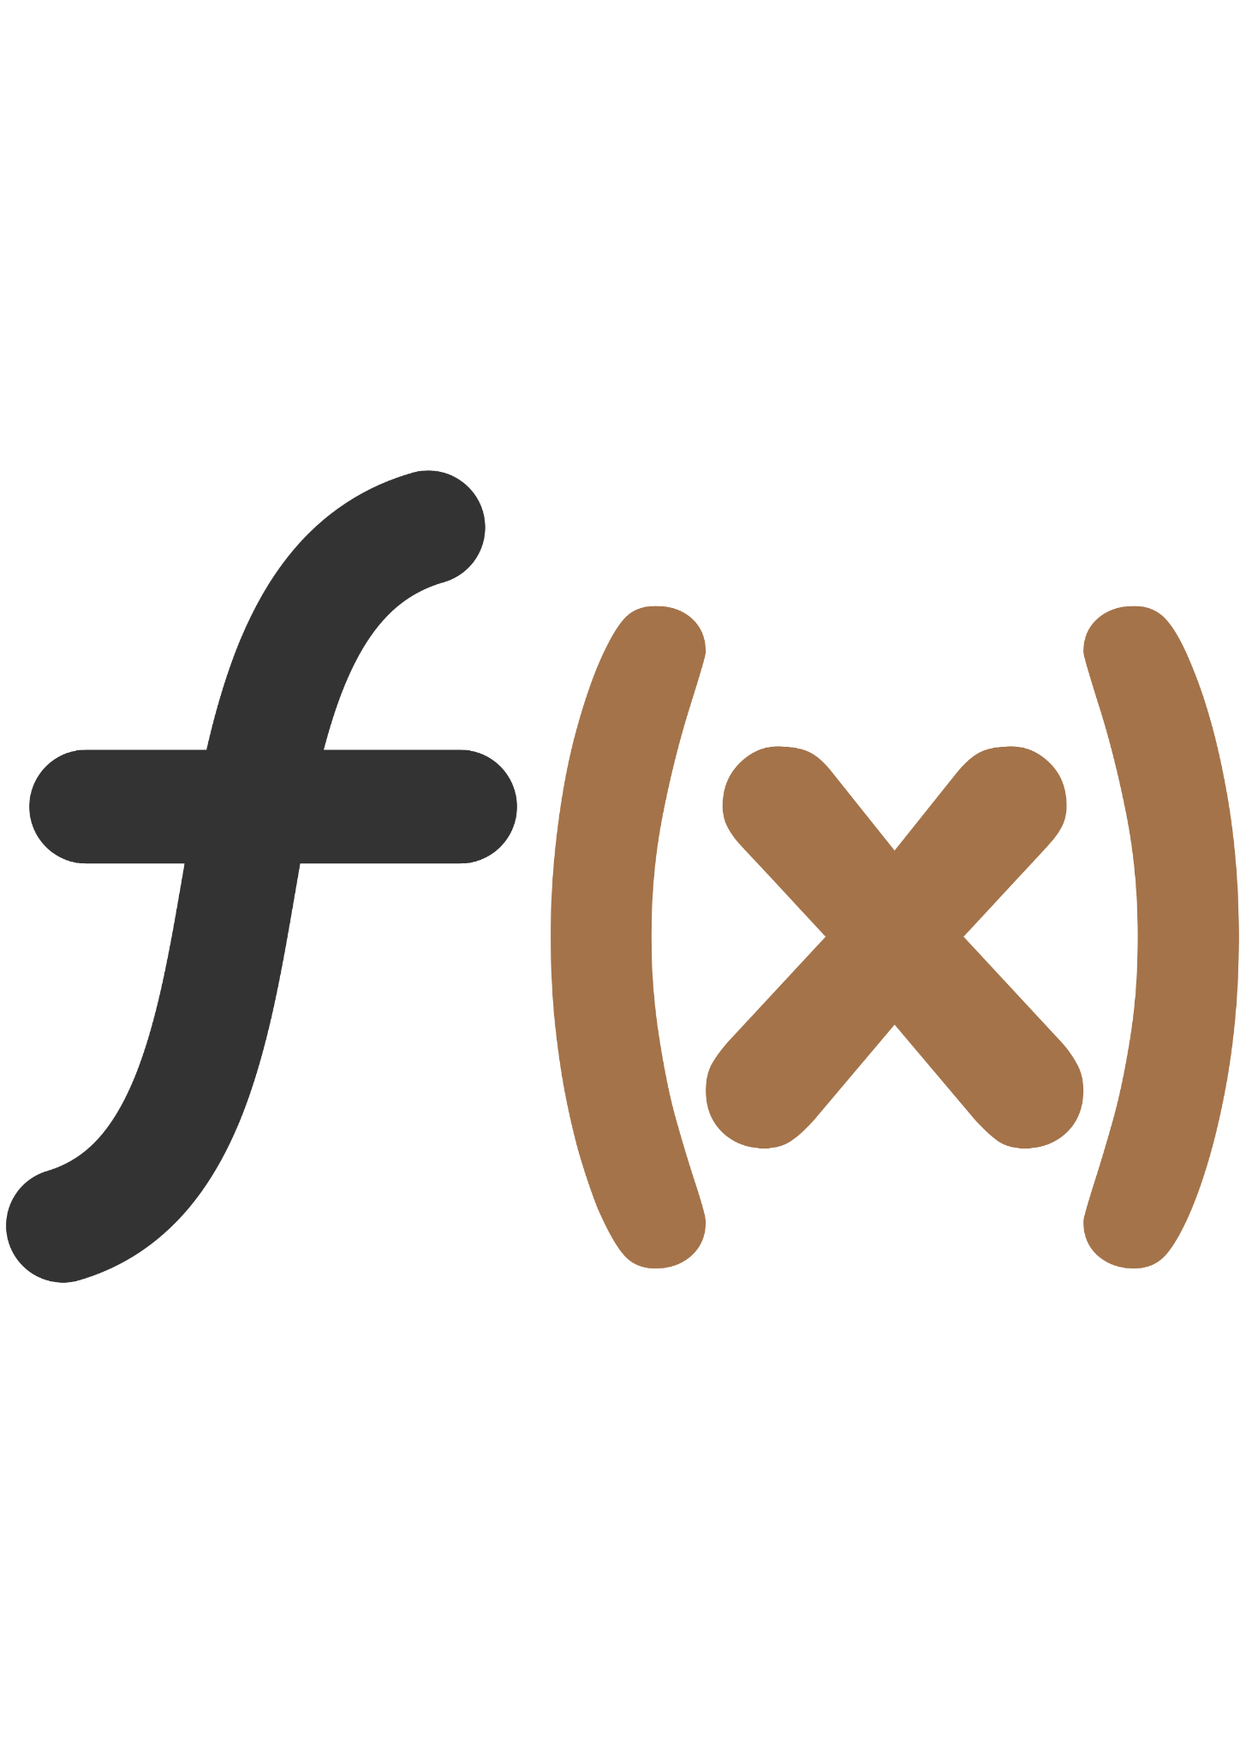
SCOPE
Algebraic
Trigonometric
Ln function
Square root
Exponential
FUNCTION TYPE

Slide 5
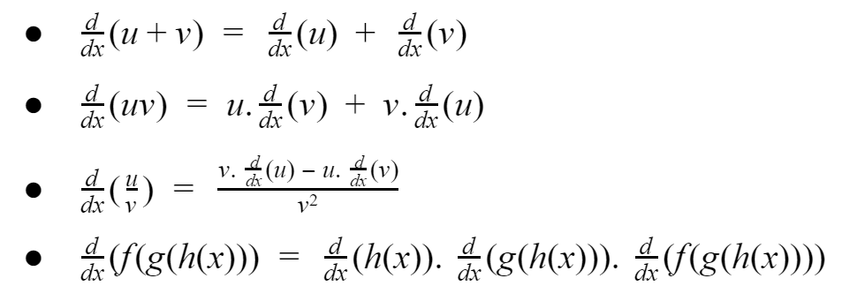
SCOPE

Slide 6
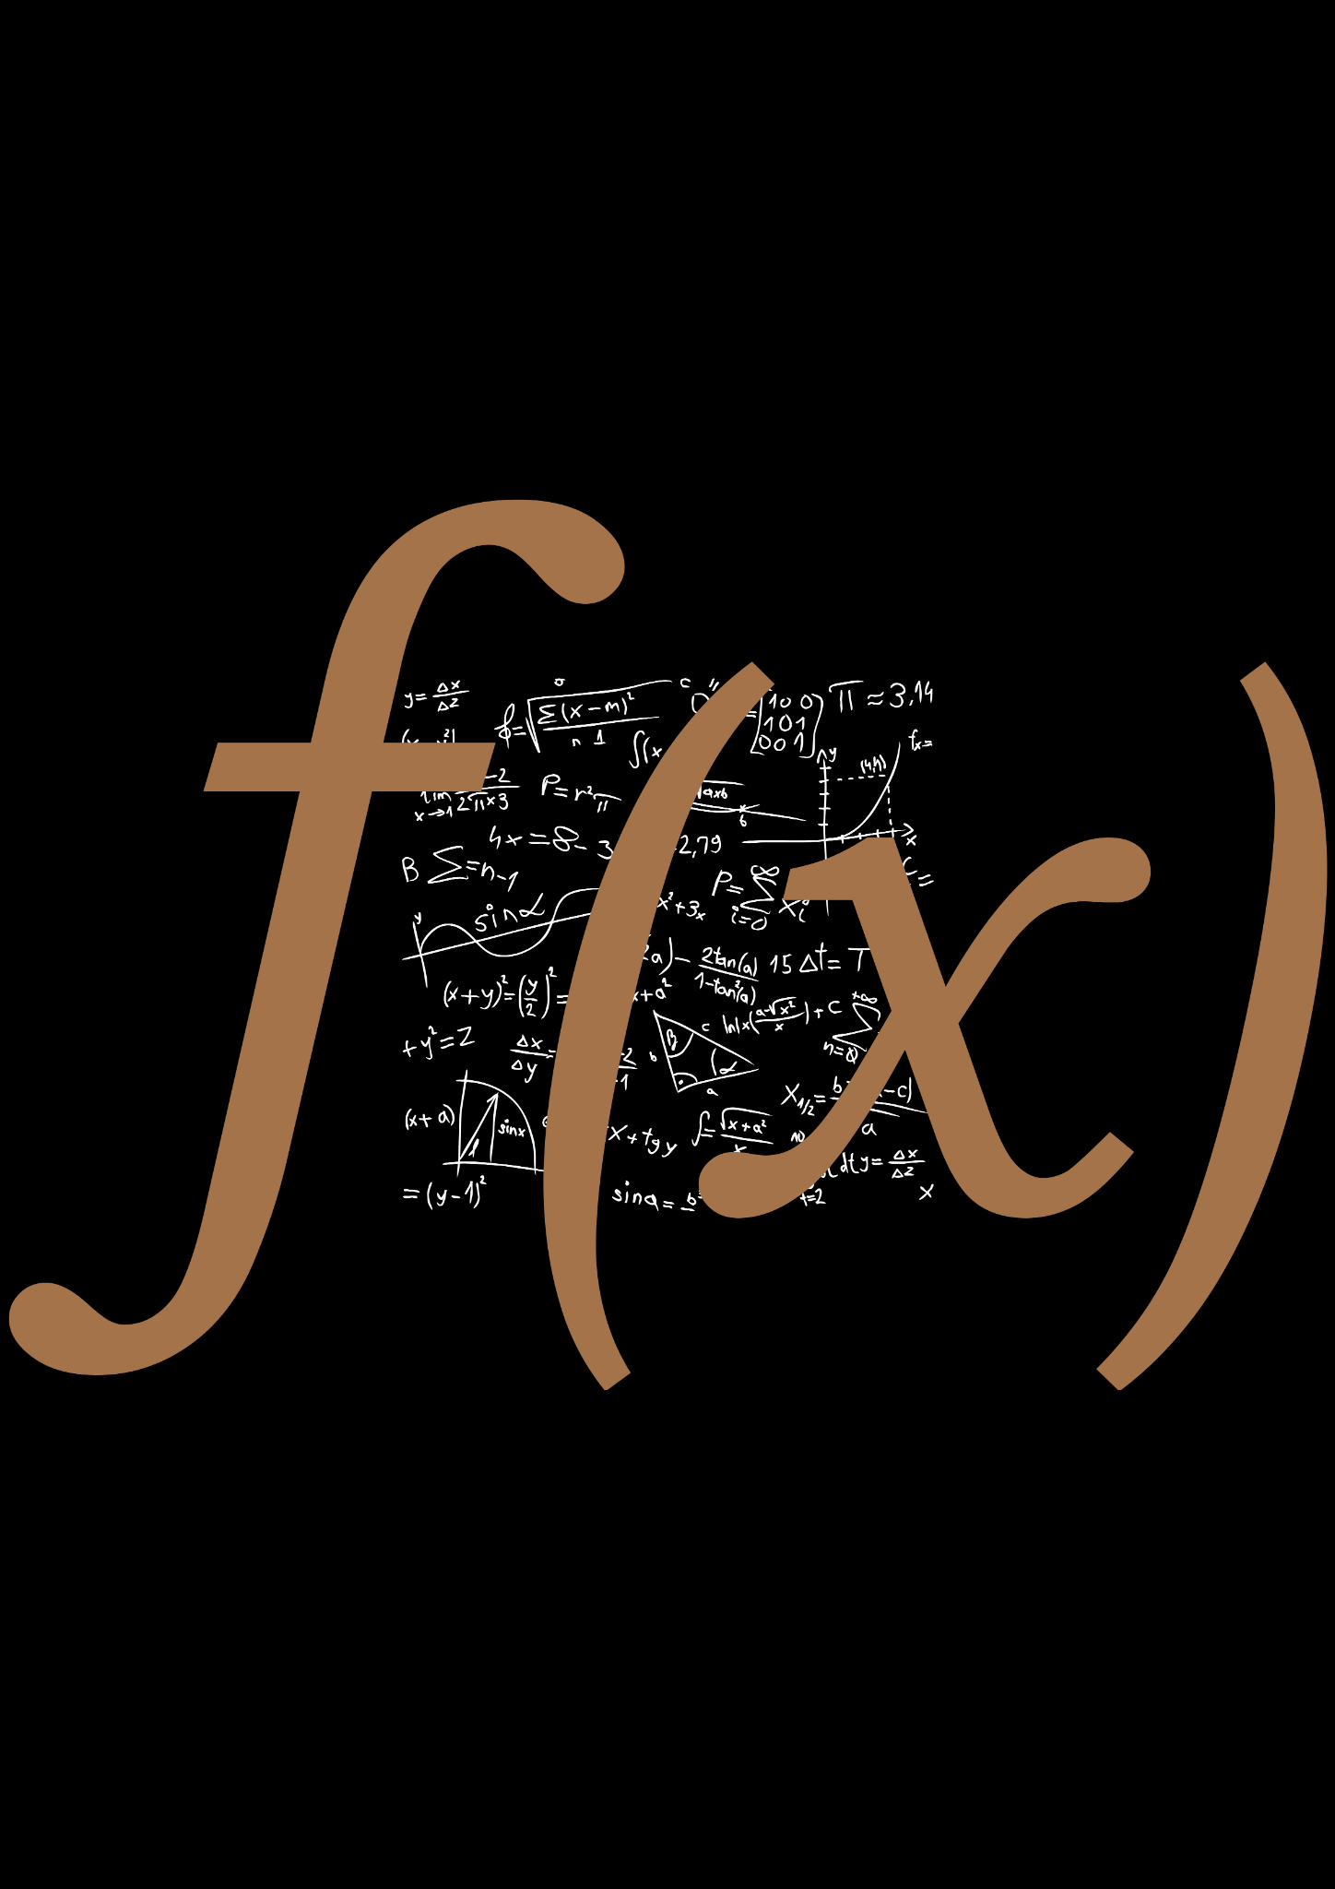





CHALLENGES
FUNCTIONS
CHAIN
PARSING
The characteristics of the given function
Chain-rule function type identification
Converting from int to string or vice-versa
CACHING
DEBUGGING
OPERATORS
Hiding for future use
Finding a bug and then correcting it
Handling negative signs

Slide 7



BACKGROUND STUDY
DIFFERENTIAL CALCULUS
TOKENIZATION
STRING-MATCHING ALGORITHMS
MEMOIZATION

Slide 8
SOFTWARE AVAILABILITY
https://github.com/saleheenshafiq9/Differentiantoo

Slide 9
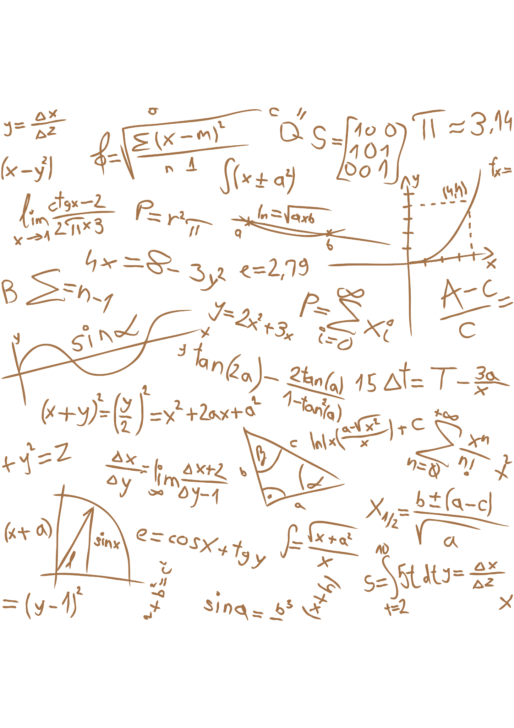
PROJECT OVERVIEW

Slide 10
( 3 * x ^ 4 )
Diff(int, char, int)
Coefficient = 3
Variable = x
Power = 4

Slide 11
A FEW CASES-
( 6 * x)
(x)
(-3*x^-4)
(5)

Slide 12
(5*x^3+3*x^2-6*x)
 | 5*x^3 | 3*x^2 | -6*x
“+” | Co_eff = 5, var = x Pow = 3, sign = ‘\0’
“-” |  | Co_eff = 3, var = x Pow = 2, sign = ‘+’
“)” |  |  | Co_eff = -6, var = x Pow = 1, sign = ‘-’

Slide 13
CHAIN RULE
ln(tan(x^2)
tan(x^2)
(x^2)
“ln”
“tan”
!match
If_ln()
If_trigon()
If_algebraic()
1/tan(x^2)
sec^2(x^2)
(2*x)

Slide 14
tan(x^2)
tan(x)
(2*x)*sec^2(x^2)
(1)*sec^2(x^2) (???)
sec^2(x^2)

Slide 15
METHOD IDENTIFIER
*
/
String-matching
UV
U/V
Others
Is there a ‘*’ between two functions?
Is there a ‘/’ between two functions?
Is there a certain word present in the function? Such as. “sin”, “sqrt” etc.

Slide 16

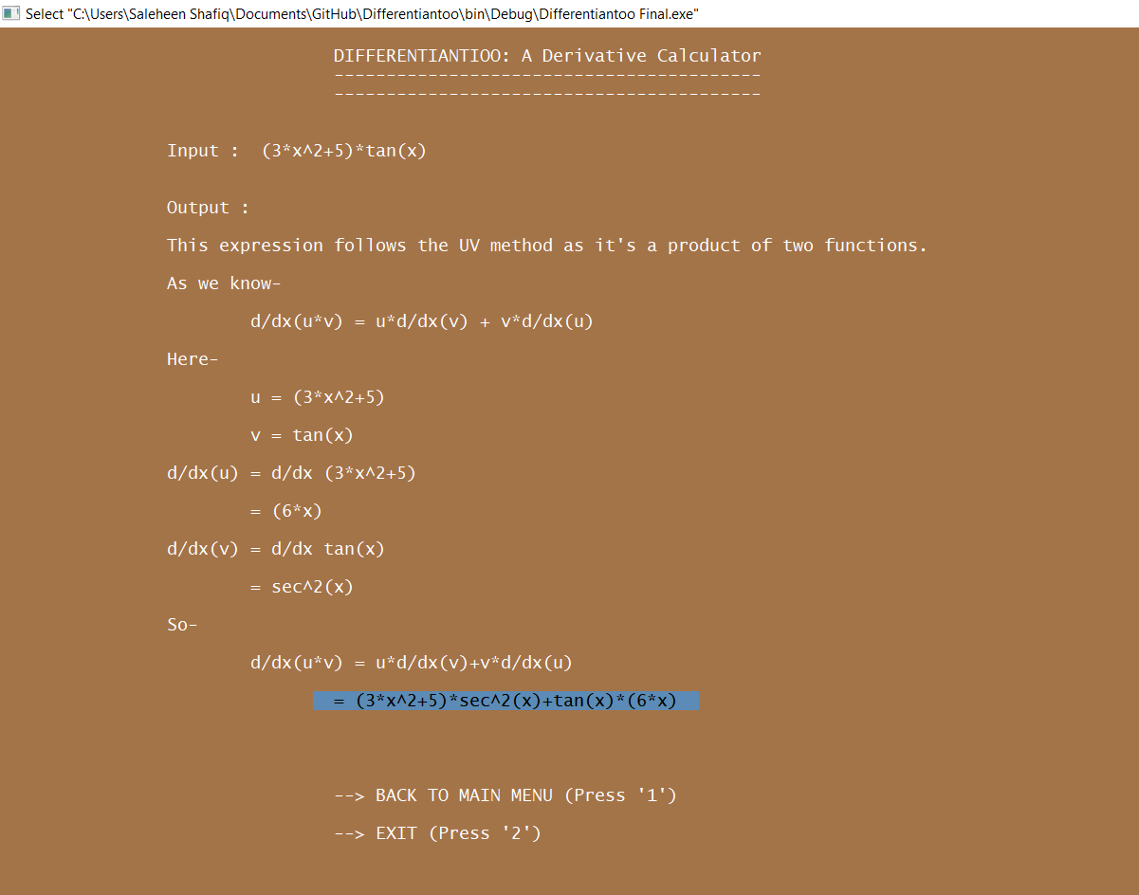
STEPS SHOWN

Slide 17
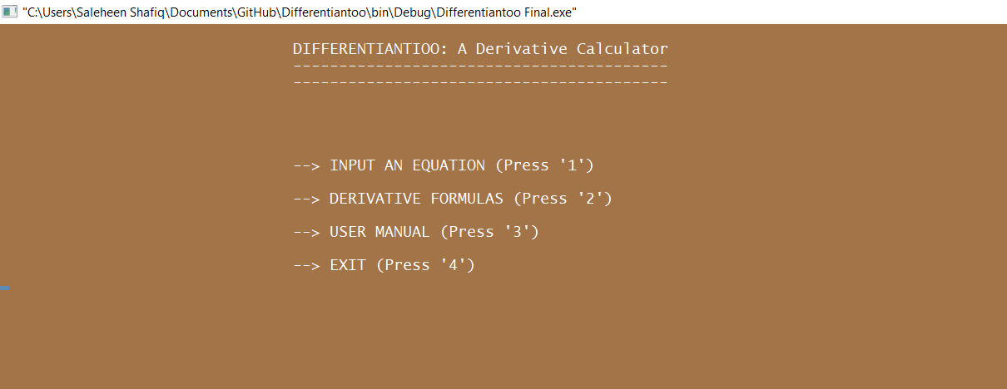
MENU

Slide 18
FUTURE SCOPES
1
Finding MAX and MIN value from a given function
2
Generating graphs to show limits
3
Adding fractional calculations
4
Adding more functions to simplify larger and more complex expressions

Slide 19
ACHIEVEMENTS
1
Implementing complex mathematical methods with logic
2
Tokenization
3
Manipulating, implementing and designing codes more efficiently
4
Improving my thought process

Slide 20
THANK YOU!

